Slide 1
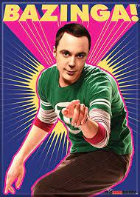
SARCASM A predictive study of sarcasm occurring in Reddit forum comments by Yuan Chan

Slide 2
Sarcasm - Definition
From merriam-webster.com:
Sarcasm refers to the use of words that mean the opposite of what you really want to say, especially in order to insult someone, or to show irritation, or just to be funny.

Slide 3
Project – objectives
Determine accuracy of predicting sarcasm using basic text analysis and machine learning approaches
Investigate if deep learning algorithms can extract further accuracy by accounting for contextual clues

Slide 4
Sarcasm –stakeholders
Business case: Contempt / exasperation is often expressed through sarcastic remarks on customer feedback portals.
Social case: identification of sarcasm can help ease interactions on social media
Linguistic case: train AI to towards a deeper grasp of complex human sentiments (humour, irony etc)

Slide 5
Sarcasm – clues for machine learning
Flipping of sentiment / polarity (from positive to negative) eg. “I just failed my exam and my dog got run over. I’m having the best day of my life”
Special words / sentences eg. “Yeah right…” or “….NOT!”
Exaggeration or hyperbole eg. “Thanks a million”
Special punctuation eg. Use of “ “ , extended punctuation “……” “!!!”

Slide 6
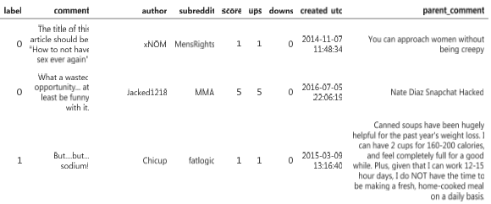
Dataset
Kaggle Dataset : data scraped from Reddit forum
150,000 subset of 1 million rows
8 feature columns
‘label’: 1 if the record is sarcastic otherwise 0
‘comment’ is the labelled text
‘parent_comment’ is the context post

Slide 7
Basic Features
Textual counts: character count, word count
Spacy part of speech (POS) tagging: word classes including adjectives, adverbs
Count vectorization (Basic bag of words)
TFIDF vectorization (including char and word n-grams)

Slide 8
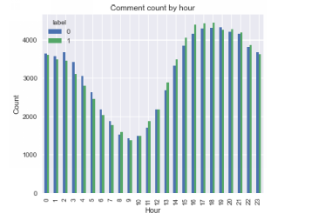
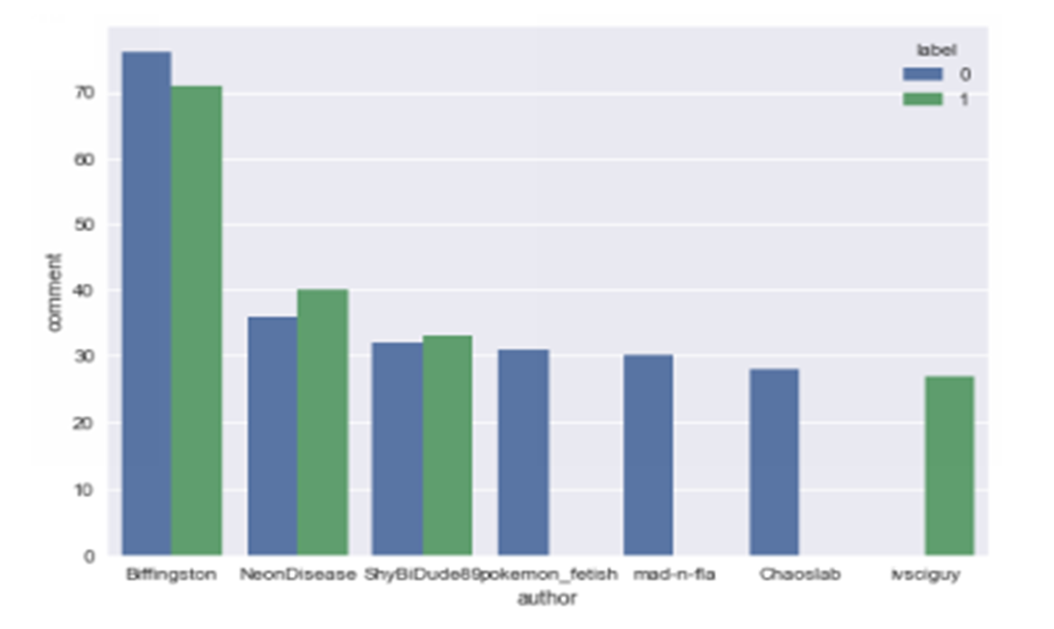
Exploratory Data Analysis
Messy dataset (self-labelled)
Artificially balanced dataset
Comment counts by individual authors

Slide 9
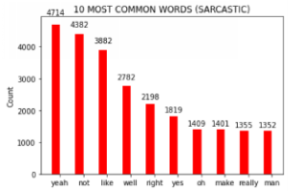
Most common words

Slide 10
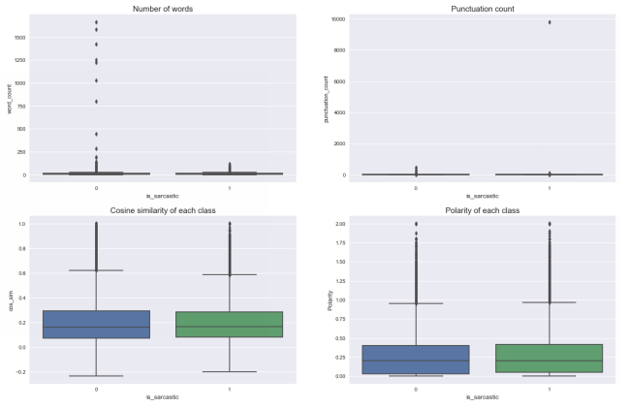
Correlation of text numerical features

Slide 11
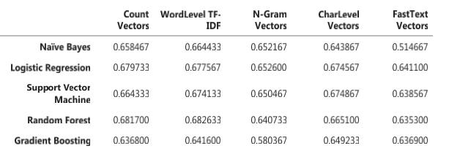
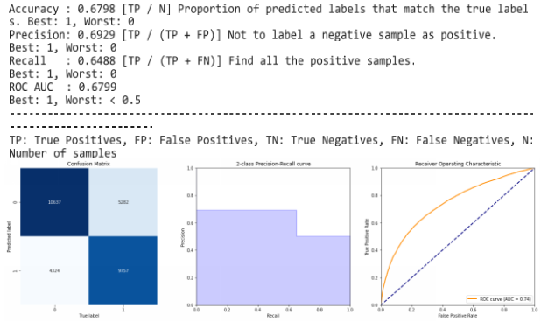
Analysis and Results

Slide 12
Deep -learning
Train a multiple - layered neural network that can explicitly account for both the ‘comment’ and its context ‘parent comment’

Slide 13
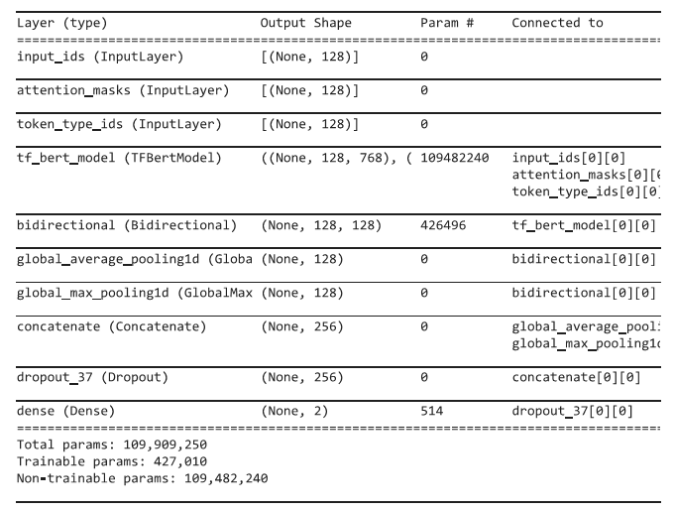






Deep Learning Model
Neural network model architecture

Slide 14
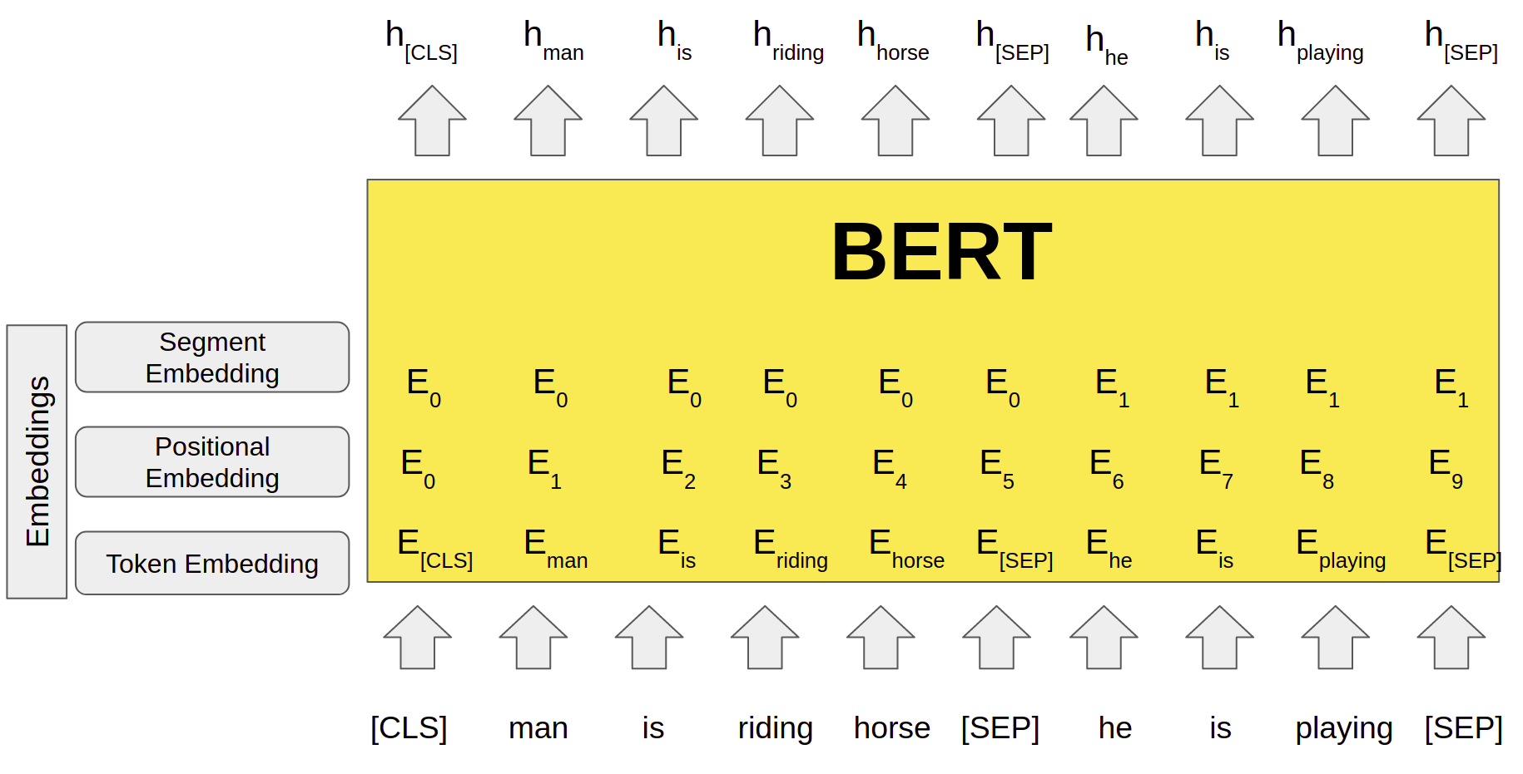
Deep -learning
BERT encoding

Slide 15
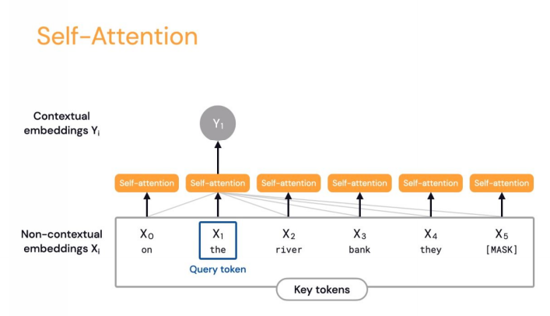
Deep -learning
Transformer architecture with ‘self attention’

Slide 16
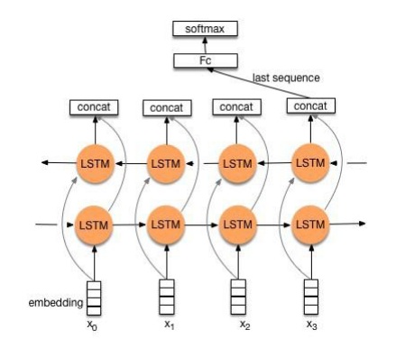
Deep -learning
Bidirectional LSTM hidden layers

Slide 17
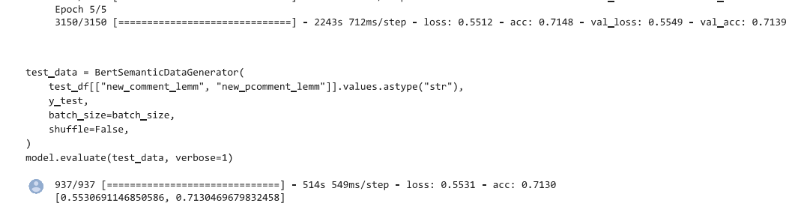
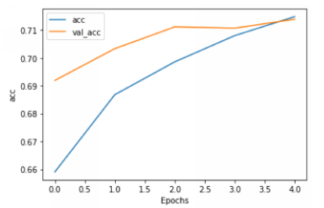
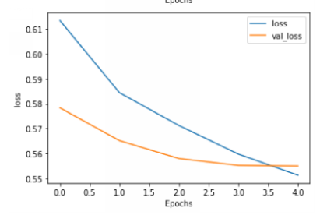
Results
Model history - loss
Model history - accuracy

Slide 18
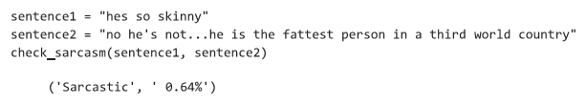
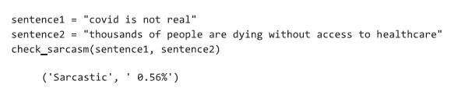
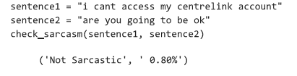
Sample Predictions

Slide 19
Key takeaways
Clean datasets with independent labelling by specialists (linguists) are essential to obtain best accuracy for sarcasm detection
Basic text analysis can yield up to 68% accuracy for this dataset at best but deep learning improves this to beyond 70%
Improved approaches will need to understand the context of the sentence to accurately determine sarcasm.
Deep learning approaches using BERT and RNN architecture offer great potential for learning context

Slide 20
Future investigations
Incorporate transfer-learning by combining with pre-trained models on eg. Personality classification, sentiment analysis to improve generalisation capability

